Slide 1

Friday 24th April 2026
INTRODUCTION TO PYTHON PROGRAMMING:
RESTAURANT MANAGEMENT WEB APP
Supervisor:
Mr. Mbietieu Amos

Slide 2
GENERAL OVERVIEW OF OUR GRAPHICAL USER INTERFACE
MANAGEMENT PAGES

Slide 3
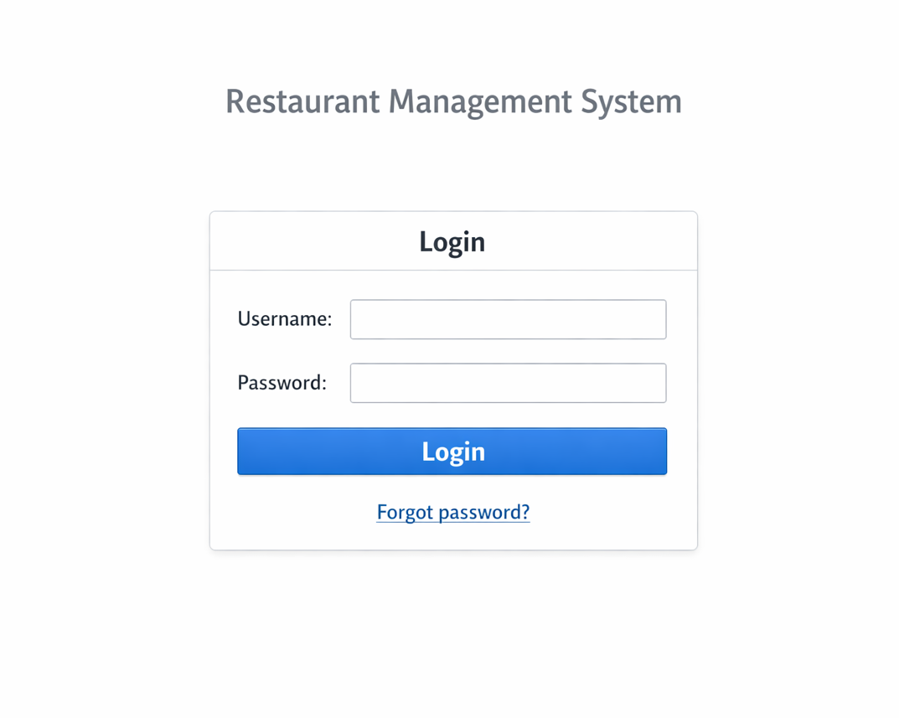
LOGIN PAGE

Slide 4
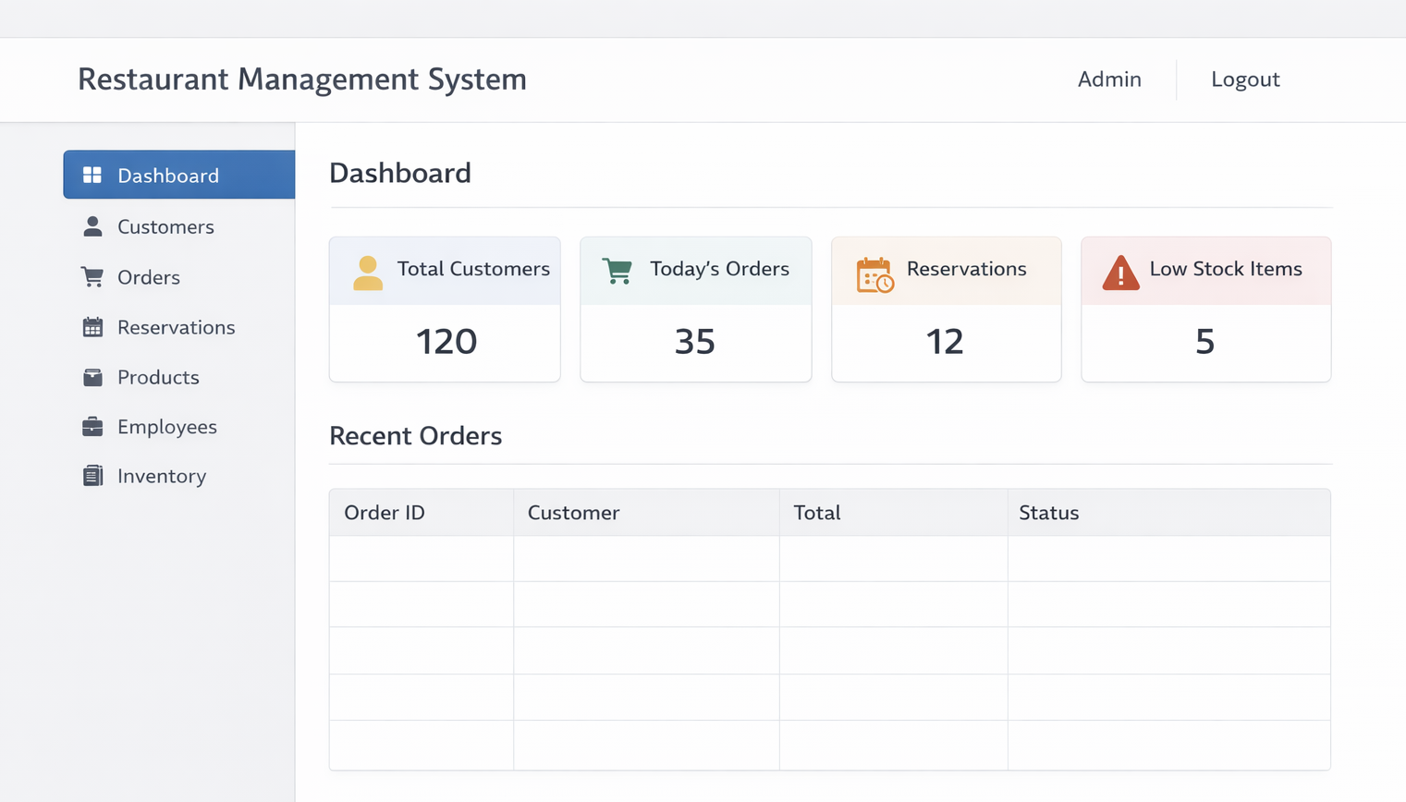
DASHBOARD

Slide 5
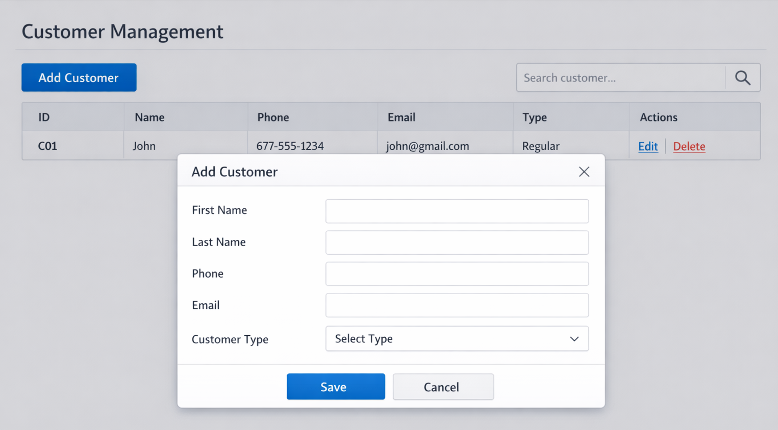
CUSTOMER MANAGEMENT PAGE

Slide 6
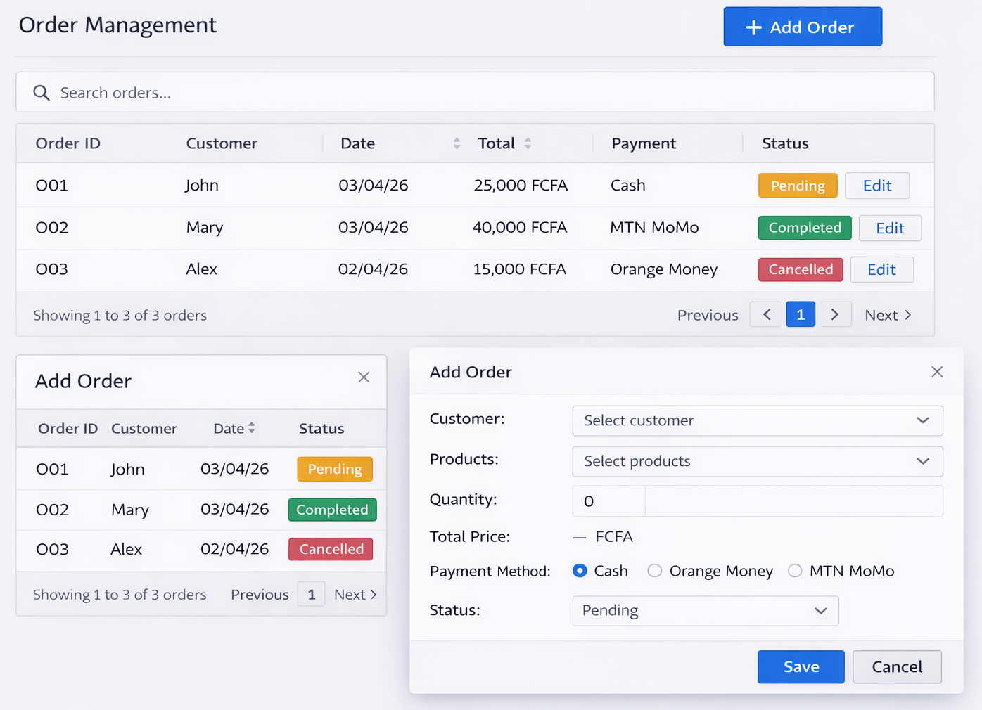
ORDER MANAGEMENT PAGE

Slide 7
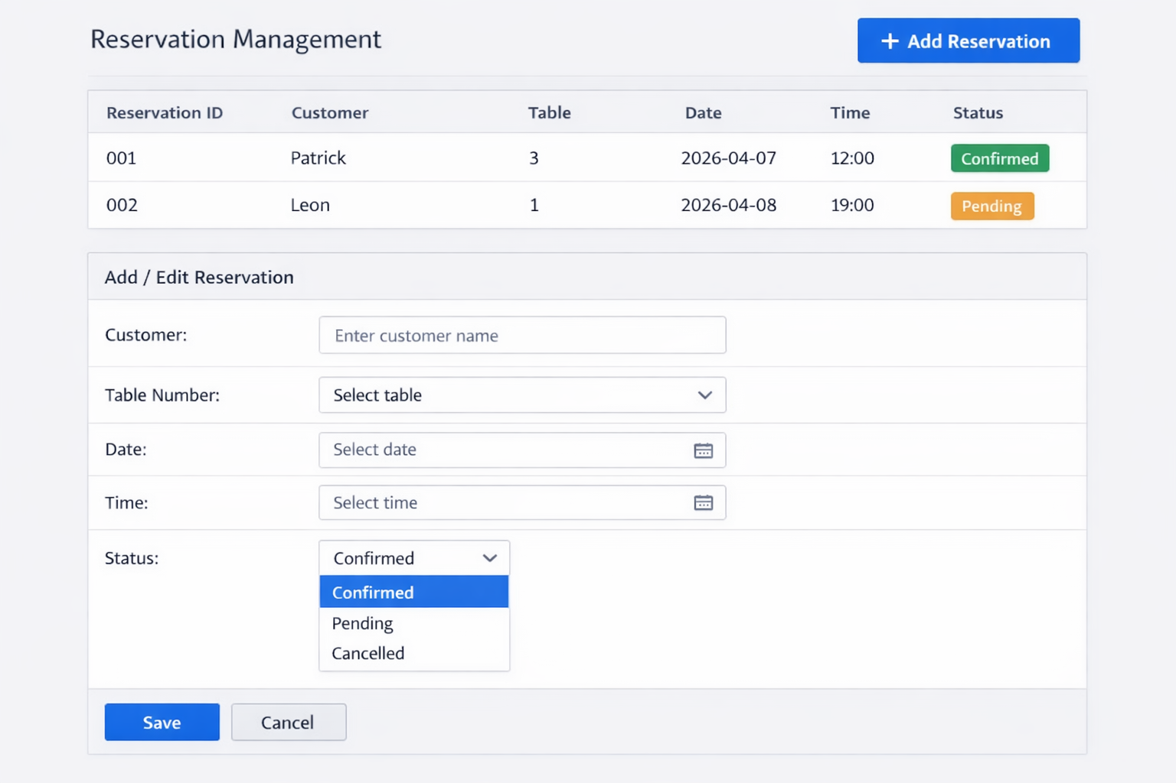
RESERVATION PAGE

Slide 8
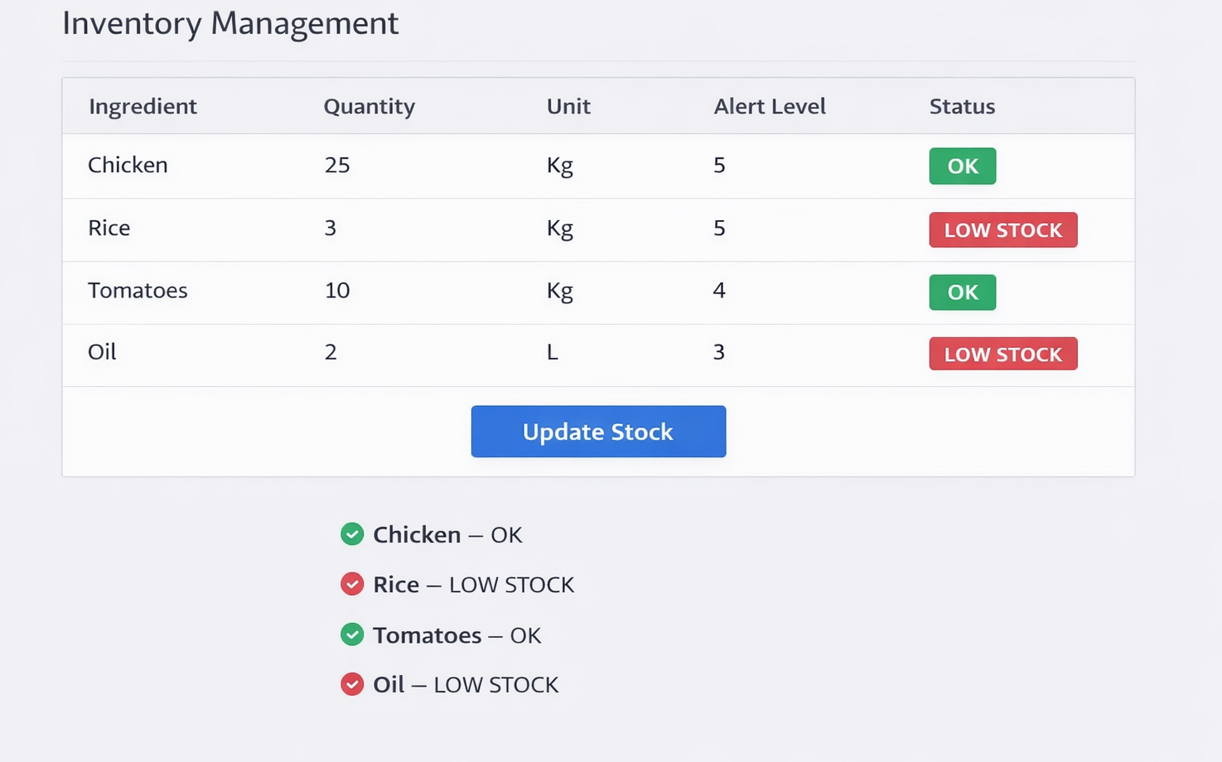
INVENTORY PAGE

